Slide 1
Building teacher agency through teacher research in pre-service teacher education in Nepal
Prem Phyak
Tribhuvan University,
Nepal
pphyak@gmail.com

Slide 2
Teacher for Teacher (TfT): Building Teacher Agency Project
Develop exploratory and collaborative skills of pre-service teachers.
Connect them with schools and in-service teachers.
Identify relevant issues; carry out research; develop plans of action and implement them during their practicum.

Slide 3
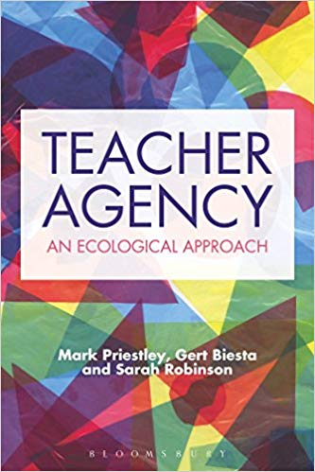
Teacher agency
“Agency as a capacity of individuals, that is, as something individuals can claim to ‘have’ or ‘possess’, but rather see it as something individuals and groups can manage to achieve—or not, of course.”
“Agency is therefore to be understood as resulting from the interplay of individuals’ capacities and environment conditions.”
(Priestley, Biesta & Robinson, 2015)

Slide 4
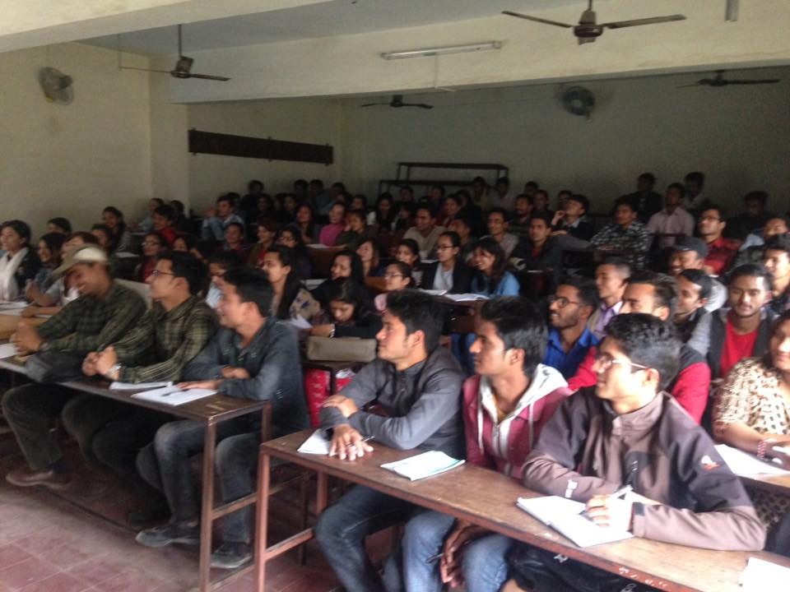
Contexts
Department of English Education Tribhuvan University, Nepal:
Central Department of Education
More than 90% teachers are graduates of this university
Pre-service English language teacher education program
Courses: interdisciplinary courses such as sociolinguistics, applied linguistics, extensive reading, ELT methods and materials, SLA, research methodology, thesis writing,
ELT Seminar and Practicum

Slide 5
Context
About 250 (in average) ELT young pre-service teachers each semester (3 semesters run consequently)
Large class: Divided students into sections (50 in each class)
Courses are developed by a group of experts and they are fixed
Resources: Lack of library resources—lack of online journal subscription
Teacher pressure and workload
Teachers cannot change courses and disconnection of the program with in-service teachers
Lecture-based, with occasional student presentations
Lack of institutional support

Slide 6
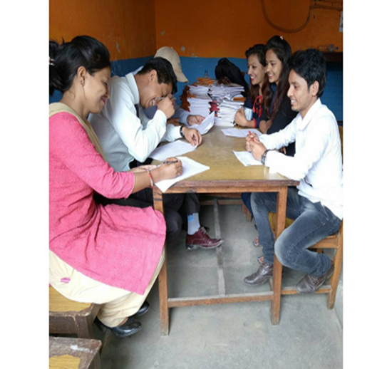
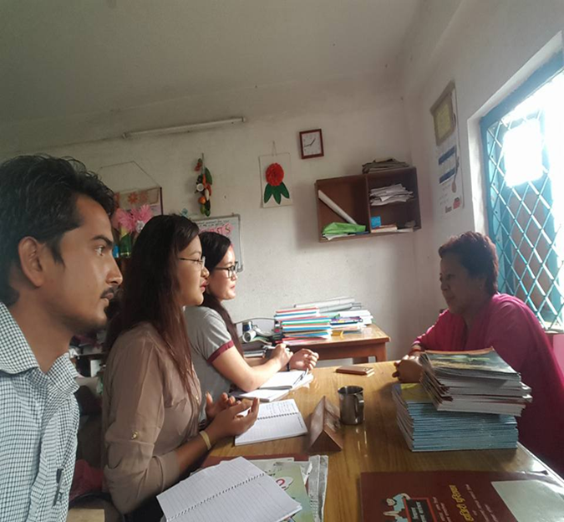
Emergent steps
1. Negotiating the syllabus (Week #1)
ELT Seminar
Practicum:
2. Connecting with in-service teachers and schools (Week #1):
Observe classes and talk to teachers
Identify issues and new ideas
3. Group formation and exploring the issue (Weeks 2 & 4):
Based on common issues (group of 3-5 members)
Exploration of issues: Reading and discussion sessions
4: Concept paper and action plans
Building consensus and describe what their project is about and why they think that they project is important
Two categories of projects: Action research and Materials development

Slide 7
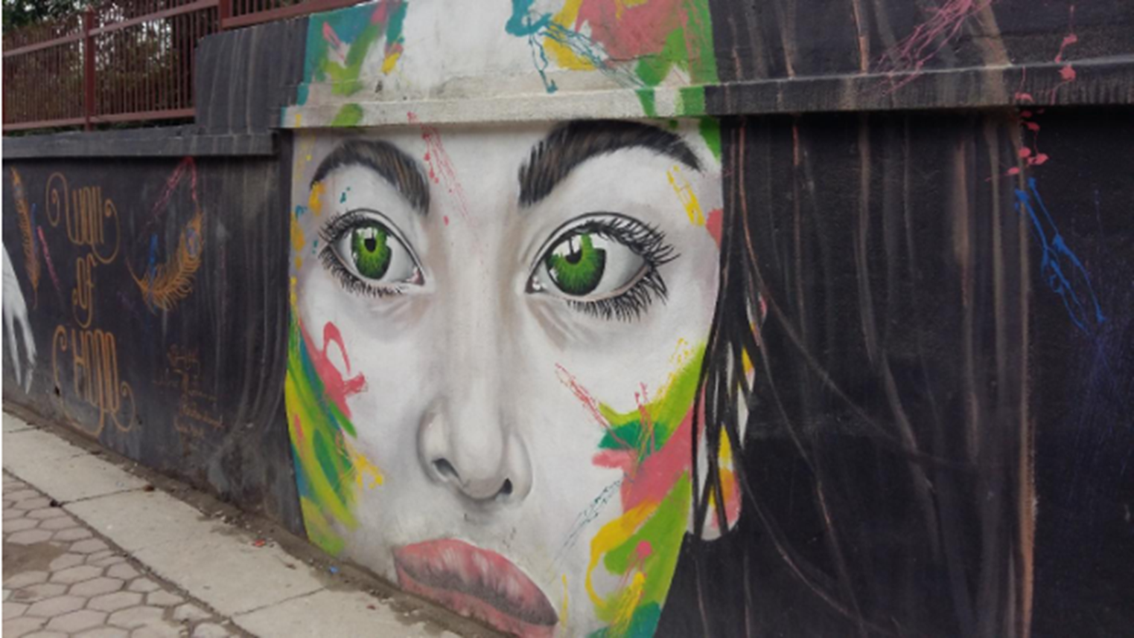
Action plans (example):
Visit different streets of city to collect graffiti (One week)
Categorized into four different themes (2 weeks)
Women and Gender Issues
Language, culture and identity
Health, sanitation and environment
Politics
Writing a material for secondary level teachers: Seeing , Noticing, Drawing Meaning and Creating (3-4 weeks)
Language related activities
Sign/symbol related activities
Social meaning and values
Students will create their own graffiti

Slide 8
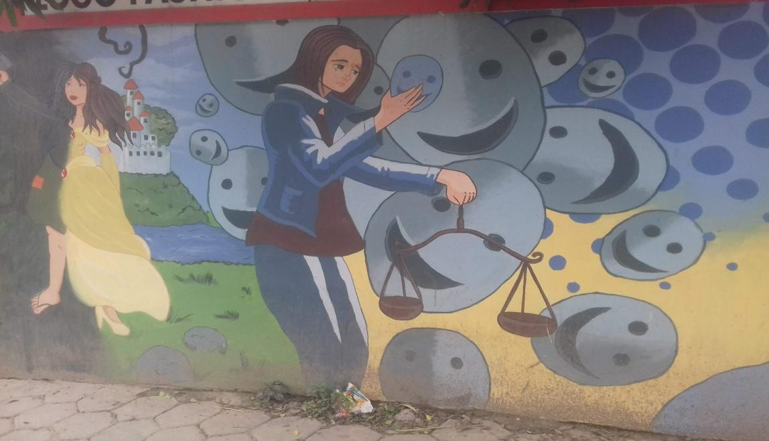
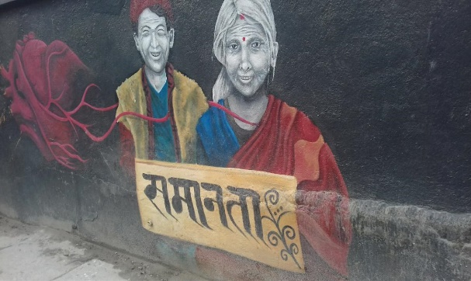
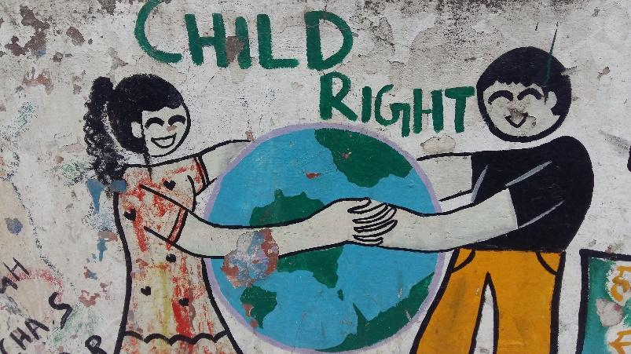
Time: 1 hour
Activity: 1 (Pair work)
Discussion on issues from the picture
Activity: 2 (Group work/Project Work)
Make a chart, with relevant pictures, that reflects the gender (in)equality in Nepal.
The major focus of this lesson are:
● Develop critical thinking about gender equality
● Speak a paragraph about gender equality
● Awareness about gender equality
● Creating graffiti

Slide 9
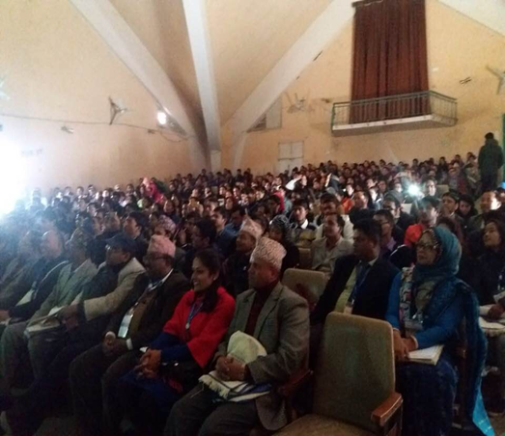
Emergent steps
Step #5: Sharing and improvement
Step #6: Implementation (4 weeks)
Practicum
Step 7 # Reflection and further improvement
Write a report
Share their own ideas how they can further improve
Step #8: Presenting their projects in seminars and conference
Small scale seminars (3-day, 2)
International conferences (3-day, 2)

Slide 10
Achievement
“I learned how to negotiate with my own friends and the teachers in schools. It is not easy—people have different ideas. But it is important to address diverse opinions. Before I used to think that I should be teaching as I was taught and read in the courses. But this process helped me develop confidence that I can do something new. I know how to use graffiti and other art-based materials in teaching. My students really liked it. They have developed some wonderful arts. All students were not able to describe graffiti, but they were motivated to talk. I think it is important to do something new which students easily understand.”

Slide 11
Conclusion
Focusing on teacher research in in-service teachers
TR focuses on building teacher agency among pre-service teachers
TR helps pre-service teachers connect with schools and better understand issues and challenges of teaching.
TR contributes to innovate and explore creative ideas among pre-service teachers.

